Slide 1

BREAST CANCER PATTERN DETECTION USING ML
BY- TEAM HARI PATTI
Sayon Sai Dutta | Aravind Kanamarlapudi | Ankita Kashyap | Manas Srivastava | Mann Bajpai

Slide 2
INDEX
What is Breast Cancer?
Malignant vs Benign
How Machine Learning can help in the field of Cancer prediction?
Visualisation of the Dataset
Our Machine Learning Model
Resources Used

Slide 3
INTRODUCTION
Breast cancer is the most frequent cancer among women, impacting 2.1 million women each year, and also causes the greatest number of cancer-related deaths among women. In 2018, it is estimated that 627,000 women died from breast cancer – that is approximately 15% of all cancer deaths among women
Doctors know that breast cancer occurs when some breast cells begin to grow abnormally. These cells divide more rapidly than healthy cells do and continue to accumulate, forming a lump or mass. Cells may spread (metastasize) through your breast to your lymph nodes or to other parts of your body.

Slide 4
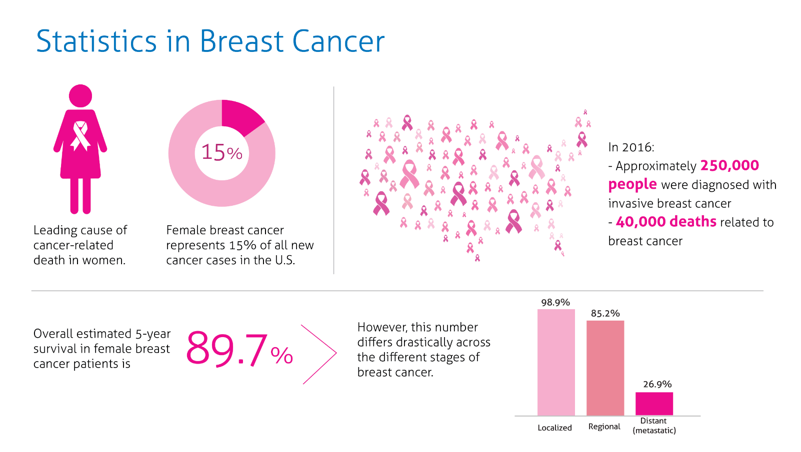

Slide 5
Substantial support for breast cancer awareness and research funding has helped created advances in the diagnosis and treatment of breast cancer. Breast cancer survival rates have increased, and the number of deaths associated with this disease is steadily declining, largely due to factors such as earlier detection, a new personalized approach to treatment and a better understanding of the disease.

Slide 6
Malignant vs Benign
Breast cancer tumours can be broadly classified into two types :-
Malignant
Benign
Malignant: Malignant breast tumors, if unchecked, will spread to the surrounding lymph nodes; then, by a process called metastasis, cancer cells will break away from the tumor and spread, through the lymph system and bloodstream, to other areas of the body. At this stage, breast cancer is deadly.
Benign: Although any lump formed by body cells may be referred to technically as a tumor. Not all tumors are malignant (cancerous). Most breast lumps – 80% of those biopsied – are benign (non-cancerous).

Slide 7
How ML can help in predicting whether a certain type of tumor is cancerous or not?
Well, the simple answer to this question is by training our machine learning model and testing against a certain dataset which is intricate and detailed enough to make the predictions enough accurate so that medical professionals can apply it in their diagnosis and can differentiate whether a certain type of cancer is malignant or benign.
The dataset contains approximately 30 columns which contains data regarding the texture, concavity, smoothness, etc. which can help a medical professional in the field to predict whether the symptoms of a patient tends to be benign or malignant.

Slide 8
Visualization of the Dataset
The dataset is taken from the Winsconsin School of Medicine and Public Health and has over 570 different breast cancer patient data.
We have used Python’s inbuilt data visualization library SEABORN to make necessary lineplots, violinplots, boxplots, swarmplots and heatmaps for a variety of data analysis purpose.

Slide 9
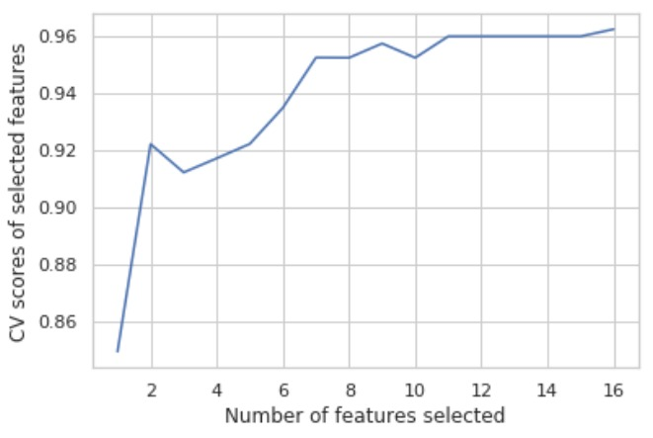
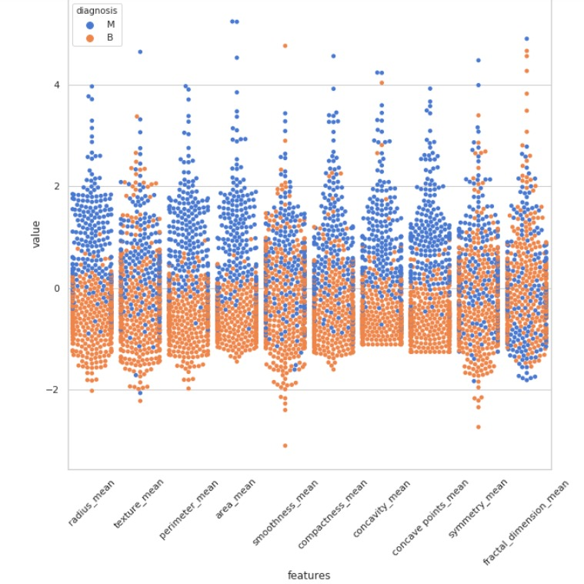
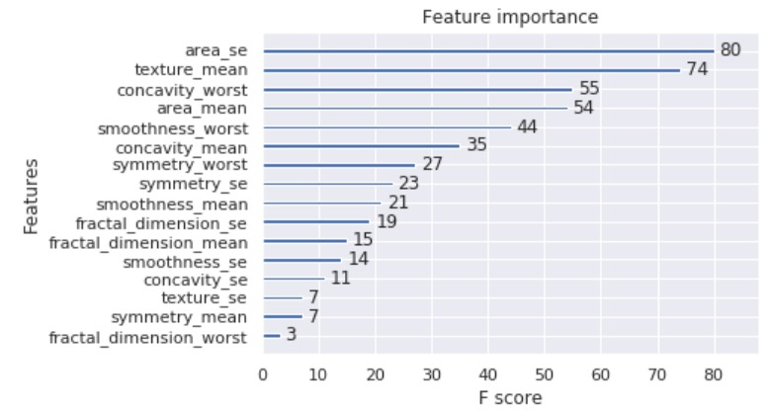
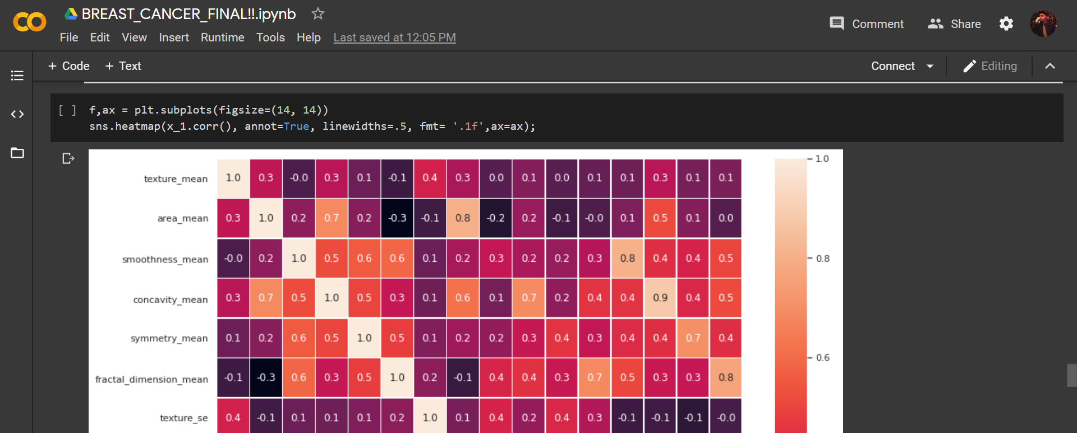

Slide 10
Our classification model
By the use of classification models like XGBOOST, we have built a decision tree classifier to classify tumours as either malignant or benign. We used inbuilt Python libraries which are commonly used for data science tasks like seaborn for data visualisation by producing heatmaps for visualising the correlation between different features of the tumour, violinplots & boxplots for outlier detection and swarm plots for a better visualisation of the classification regarding which data is suitable and which is not.

Slide 11
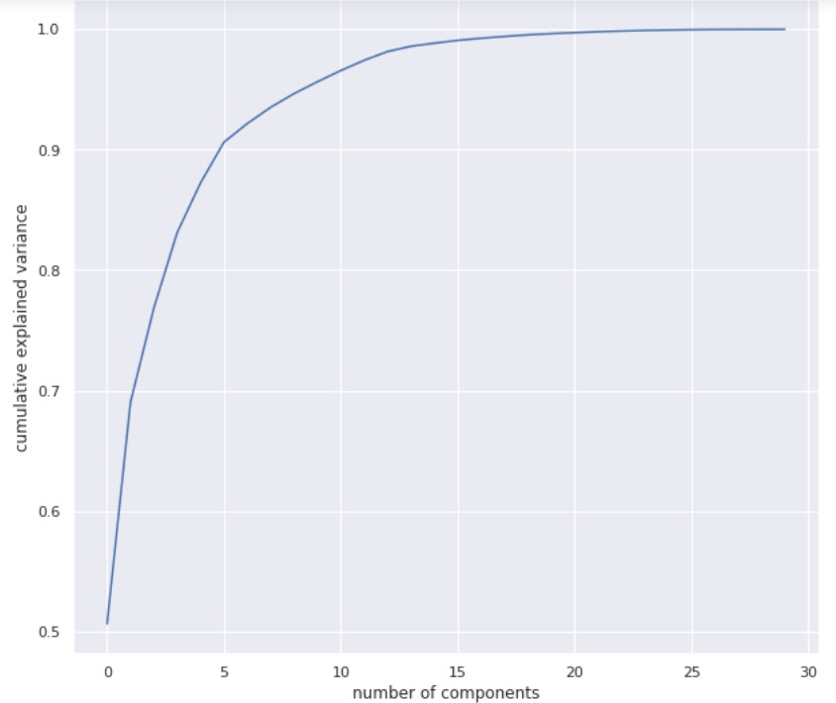
The x axis represents the number of components set by the PCA and on the y-axis, we have the cumulative explained variance

Slide 12
Resources Used
Winsconsin School of Medicine and Public Health (Breast Cancer Dataset)
Google Colab
Python libraries like Pandas, Numpy, Seaborn and Scikitlearn.
Cancer.stonybrookmedicine.com (For more information on breast cancer)

